Slide 1
Data Representation
Learning Intentions
Students should be able to:
Describe the difference between data and information
Describe how data is stored in the following units: bit, nibble, byte, kilobyte, megabyte, gigabyte, terabyte
Identify the following data types: numeric (integer and real), date/time, character and string

Slide 2
Data and Information
KEY FACTS
Raw data is a string of meaningless information that has not been given a context. For example: 1643 or Blue car or 75%
Information is data that has been given a context and is meaningful. For example: There are 1643 pupils in a school. The blue car is parked illegally. John attained 75% in his Digital Technology Examination.

Slide 3
Data OR Information?
Jane Taylor
DATA
378493
DATA
Green traffic light to GO
INFORMATION
Dave Long Gym member No. 27439
INFORMATION
Student Activities Pages 5 to 6

Slide 4
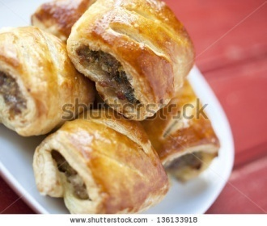
Joe’s Bakery
Monday 180 Units food sold
Tuesday 120 Units food sold
Wednesday 80 Units food sold
Thursday 110 Units food sold
Friday 240 Units food sold
Saturday 260 Units food sold
Friday and Saturdays are the busiest day of the week
Wednesday is the slowest day of the week
More staff required on busier days
Baking requirements can be estimated for each day to reduce wastage
Marketing e.g. Special offers could be advertised for a Wednesday to increase sales
Information
Decisions

Slide 5
Units of Data
KEY FACTS
Units of data are a measurement used to describe digital storage size.
The smallest unit is a bit. A single bit may contain a binary value of 0 or 1, On or Off, True or False.
There are 8 bits in a byte. A byte can store 256 values.
Most files contain thousands of bytes and are measured in kilobytes, megabytes, gigabytes and terabytes.

Slide 6
Units of Data
Units of Measurements in order of size
Unit Value Equivalent to bit 0 or 1 1/8 byte nibble 4 bits ½ byte byte 8 bits 1 byte kilobyte (KB) 1024 bytes 1 kilobyte megabyte (MB) 1024 megabytes 1 gigabyte gigabyte (GB) 1024 gigabytes 1 terabyte
Student Activities Pages 7 to 8

Slide 7
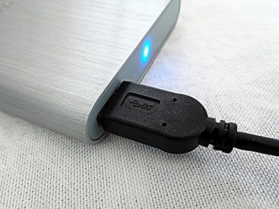
Storage and Units of Data
Storage Facility | Approximate Storage Capacity Range | Example of Use
CD (Optical Device) | 700MB | A selection of school photographs
USB Memory Pen | 1GB to 1TB | Backup of Coursework
Cloud Storage | Depends on the package. Some broadband providers offer 5GB for free. Others up to 100GB. Companies can purchase huge amounts of cloud storage e.g. 5TB or more | Databases, Individual and Shared Files
External Hard Drive (SSD) | 1TB TO 4TB | Teacher Resources File Backups for Safe
DVD (Optical Device) | 4GB to 9GB | School Play

Slide 8
EXAMPLE FILE SIZES
File | File Size
A photo | 3MB
A song | 5MB
A film | 700MB
Ultimately, the more information, the larger the file will be
What will take up more space:
A 2 page word document? OR A photo of a dog?
Notes:
In pairs, the pupils will look at the file size of a word document on their computer and download an image of a dog and compare the file size before discussing with the rest of the class

Slide 9
UNITS OF DATA SPOT CHECK
How many bits in a nibble?
4 bits
How many nibbles in a byte?
2 nibbles
How many bytes in a kilobyte?
1024 bytes
How many megabytes in a gigabyte?
1024 megabytes
How many gigabytes in a terabyte?
1024 gigabytes
What is bigger than a terabyte?
A petabyte

Slide 10
Representing Data
KEY FACTS
A data type classifies the data so that the computer program recognises the type of data each variable will hold and alerts the user to which type of data they can enter.
Common types of data include: Numeric (Integer and Real), Date/Time, Character and String.

Slide 11
Representing Data
Integer numbers include positive and negative whole numbers e.g. 10, -5
Real numbers contain decimal values, although can also store whole numbers e.g. 12.2
Date/Time can be set up to record date or time data in a specific way. For example: Short Date 15/01/15, Medium Date 15-Jan-15, Short Time 15:30
Character may store a single letter, number or symbol e.g. Y or N
String can contain combinations of letters, numbers and symbols e.g. telephone number, Postcode, Passwords.
Boolean can represent 1 or 0, On or Off, True or False

Slide 12
Data Type?
10th February 2017
Date/Time
Newsletter Required?
Y/N – Boolean
Hunter
String
12.5
Real
20
Integer
Student Activities Pages 9 to 10

Slide 13
Data Types
Telephone must be text so the 0 shows in the number. It is not used for calculations and is therefore a string.
Currency
Text
Date/Time
Number

Slide 14
Representing Images
Learning Intentions
Students should be able to:
Demonstrate understanding of how pixels are used in image representation
Demonstrate understanding of how image resolution affects file size
Describe how vector-based graphics and bitmap graphics are stored and the differences between them
Demonstrate understanding of how buffering and streaming are used to support the transfer of moving image files
Pixels Movie

Slide 15
Representing Images
Student Activity Page 11
KEY FACTS
Images are converted into binary in order for a computer to understand and process them.
Digital images are made up of pixels (short for Picture Element) and when they are displayed onto our screen it is divided into thousands of pixels arranged in rows and columns.
The number of pixels used to create a digital image is referred to as the ‘resolution’ and the higher the pixel count, the better the quality of the image.
Website Links
Image Resolution
Image Conversion

Slide 16
Pixel Image in Black and White

Slide 17
Pixels - Colour Images
In reality most images today are in colour. The number of bits represents how many colours are available for each pixel. A 2-bit will give us 2 squared i.e. 4 more colours to use. For example we could say: 00 – Green 01 – Red 10 – Black 11 – Grey In Summary the number of colours available depends on the number of bits per pixel.

Slide 18
Pixels - Colour Images
The number of bits per pixel is known as the Colour Depth. Therefore, the more colours required, the more pixels needed to store the available colours. When you take a photograph using a digital camera or scan an image, you are creating a bitmap graphic. As information must be stored about every single pixel in the image, the file size can often be large.
Student Activity Page 12

Slide 19
Image Resolution
Pupil Activity Page 13
KEY FACTS Image resolution refers to the number of pixels in an image.
To identify the resolution we can right hand click on an image and choose the property option (see screen shot below).
Resolution is sometimes identified by the width and height of the image. In the example below, the image property shows this particular image as 280 pixels x 210 pixels = 58,800 pixels.
The input resolution can also be measured in Pixels per Inch (PPI), Pixels per Centimetre (PPCM) and Dots per Inch (DPI). This determines the amount of detail the image has and therefore the quality of the image.

Slide 20
Can you spot the key differences between the 2 images?
Vector Image
Bitmap Image

Slide 21
Vector Based Versus Bitmap Graphics
KEY FACTS
Vector Graphics
Vector graphics are created in graphic packages
Vector graphics consist of shapes, referred to as objects
Each object can be edited separately and elements can be grouped
Images are usually more precise that bitmaps
The file size is usually small
When a vector graphic is resized it does not lose quality
Common file formats include: .svg, .xml

Slide 22
Vector Based Versus Bitmap Graphics
KEY FACTS
Bitmap Graphics
Bitmap graphics are created when using a digital camera or an image is scanned
A bitmap graphic is made up of pixels
A bitmap graphic is made up of many different colours
Individual pixels can be edited
The file size is usually large
When a bitmap is re-sized it loses quality
Common file formats include .bmp, .jpeg, .png, .gif, .tiff
Student Activity Page 14

Slide 23
IMAGES SPOT CHECK
What is image resolution?
Image resolution refers to the number of pixels in an image
How is image resolution identified?
Right Hand Click on an image and choose the property option
What is the best way to enlarge an image without destroying its quality?
Set the DPI at the highest possible number, Use Specialist Software e.g. Perfect Resize
2 Facts on Vector Images
2 Facts on Bitmap Graphics

Slide 24
Streaming and Buffering
What does it mean when we talk about streaming?
When does buffering occur?
What factors affect the smooth streaming of multimedia to our screens?
What do you know about streaming and buffering?

Slide 25
Streaming and Buffering
Student Activity Page 15
KEY FACTS
Streaming is essentially multimedia constantly being received by a provider using the internet, for example: SKYE, NOW TV, AMAZON. Streaming is an alternative to downloading the whole file before watching.
When you are streaming a video on your portable device, there is nothing more annoying than it constantly pausing! In order to prevent a video from stopping to load your screen pauses and this is where buffering comes in.
Buffering allows the video stream to catch up and then the video plays again. It uses cache which stores the data, so that the video can be played without further interruptions.

Slide 26
CLASS DEBATE
Class Debate Scenario: Jim is having his friends around to watch a movie tonight. He can’t decide whether to download the movie in advance OR to just stream it when they arrive.
FOR DOWNLOADING TEAM research examples: Advantages of Downloading, Disadvantages of Streaming
FOR STREAMING TEAM research examples: Advantages of Streaming, Disadvantages of Downloading

Slide 27
Class debate feedback: Stream OR Download!
Advantages:
Don’t have to store the file to watch it
May decide not to continue watching
Disadvantages:
Have to download again if you want to rewatch (data)
Affected by bandwidth – buffer
Can’t pause and start again
Advantages:
Can access file when you don’t have access to the internet
Sometimes you get a better quality for download wh 1080 vs 480
Disadvantages:
Takes up storage
STREAMING
DOWNLOADING

Slide 28
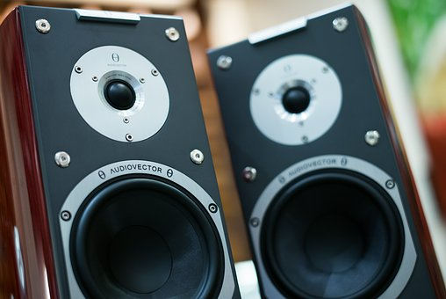
Representing Sound
Learning Intentions
Students should be able to:
Describe factors that affect sound quality, including sample rate, bit depth and bit rate when recording sound
Explain the need for analogue to digital conversion in sound recording
Sound Quality

Slide 29
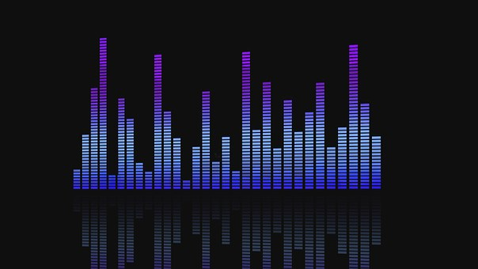
Representing Sound
KEY FACTS
Sound is a type of wave that is made up of continuous vibrations i.e. small waves of pressure in the air, detected by the human ear and processed by our brain. However, our love for music and film means that we require a way of record sound to be able to play it over and over again.
Sound is usually recorded through a microphone diaphragm, for example, available on an audio recorder or a mobile phone. The microphone diaphragm detects changes in atmospheric pressure caused by acoustic sound waves.
We used to record sound as analogue on a digital cassette tape, however, there were often imperfections of crackling and background noise when it was played back.
As we use digital devices today sound must be converted from an analogue to a digital sound using binary for computers to be able to process it. An analogue to digital converter is required for this job. This works by sampling the sound waves at regular time intervals. The more frequently the samples are taken, the more accurate and better quality the sound.
Student Activity Pages 17 & 18

Slide 30
Sound Sampling Activity
ORIGINAL GRAPH
NEW GRAPH
What is the difference and the key reasons for this?

Slide 31
Representing Sound
Student Activity Page 19
KEY FACTS
The key factors that affect sound quality include: Sample Rate, Bit Depth and Bit Rate.
The bit depth is the number of bits of information in each sample and is related to the amplitude measurements. If we were to merge more than one sound there would be lots of calculations, which involve the use of decimal places taking place (producing a more complicated illustration).
If each sound is only an approximation of the original analogue it may not appear to sound like the original. Bit depth commonly ranges from 8 bit to 32 bit and the higher the bit rate the more precise the sound calculation and the better quality the sound.
The bit rate is the bit depth x sample rate, meaning that when either the bit depth or sample rate rise, so does the bit rate.
How Digital Audio Works – watch the video and summarise the key points!

Slide 32
Data Portability
Learning Intentions
Students should be able to:
Demonstrate understanding of data portability and a number of common file formats
Demonstrate understanding of the need for data compression

Slide 33
Can you guess the file type?
.doc
.wav
.txt
.wmv
.avi
.mp3
.gif
Notes:
.doc is a word document
.wav is an audio file
.txt is a text file
.wmv is a movie file
.avi can contain audio and video data
.mp3 is an audio file
.gif is an animated file

Slide 34
Data Portability
Student Activities Pages 20 to 22
KEY FACTS
Data Portability is to do with how easily data can be transferred from one system to another without having to re-enter the data.
It is quite likely that you frequently transfer many different types of files such as word-processed, images, audio and video files from one place to another. Examples may include: images from your mobile phone to Facebook, a homework report from your personal PC to the school network. The format in which your document is saved will indicate whether it is portable between different systems of application programmes.
Examples of file formats that support data portability include: jpeg, tiff, png, pict, gif, txt, csv, rft, mp3, mp4, midi, mpeg, avi, pdf, wav and wmv.

Slide 35
File Type Extensions – Activity 1
JPEG Joint Photographic Expert Group
TIFF Tag Image File Format
PNG Portable Network Graphics
PICT Pune Institute of Computer Technology
GIF Graphic Interchange Format

Slide 36
File Type Extensions – Activity 3
MP3 Part of the Moving Pictures Expert Group (MPEG3) Compressed Audio File
MP4 Part of the Moving Pictures Expert Group (MPEG4) Compressed Video File
MIDI Musical Instrument Digital Interface
AVI Audio Video Interleaved
WMV Windows Media Video
WAV Waveform Audio File Format

Slide 37
File Type Extensions – Activity 5
PDF Portable Document Format
TXT Text Document
CSV Comma Separated Values File
RTF Rich Text File

Slide 38
Can you guess the file extension?
Large raster file referred to as a bitmap image Made up of tiny pixels Formatting maintained across devices Can be compressed to reduce file size Does not lose its quality
File format used for compressing audio Relatively small file size, but retains quality
Most popular for downloading music
Developed by Adobe, viewable using Acrobat Reader Can be created from a range of files e.g. Word PDF smaller than original file Transferrable onto most systems
Originally designed for streaming Smallest video files over the web Small file size also decreases the quality
Notes:
TIFF
MP3
WMV
PDF

Slide 39
File Transfer and Compression
KEY FACTS
Sometimes files need to be converted to another format. Reasons may include: - to allow viewing on a different software application - to compress the file into a smaller size - to convert an old file into a more modern format - to transfer a file onto a different storage medium - so that it is more suitable for the web or to send via. email
Special software may required to perform this operation e.g. 7-Zip, IZArc, WinRar
Data compression Data compression involves storing a file in a format that takes up less space Data compression can be done by either using compression tools or by saving the file in a different format, where the option is available. Key attributes of images will be changed.
Website Research
http://www.bbc.co.uk/education
I am sure you can find other relevant websites through a GOOGLE search
Student Activities Page 23

Slide 40
Data Compression
Data Compression

Slide 41
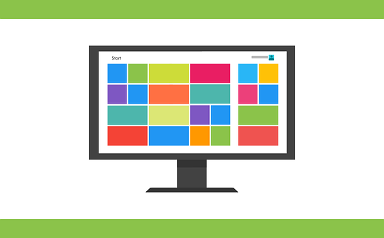
System Software
Learning Intentions
Students should be able to:
Describe the functions of system software, referring to allocating memory, storage and processing time
Describe real-time, batch and multi-user modes of processing
Describe common tasks carried out by the utility applications
Describe the role of anti-virus software and the importance of regular updates
Student Activity Page 25
Operating System Intro

Slide 42
System Software Diagram

Slide 43
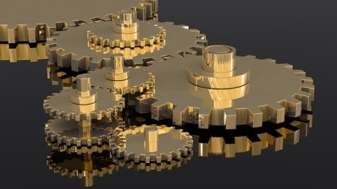
Types of Software
Software can divided into two categories: System Software and Application Software.
Systems software describes the programs which help the user control and make best use of the hardware
Applications software describes programs that have been written to perform a specific task

Slide 44
System Software
System Software can be further broken down into:
1. Operating Systems
Controls the hardware (input and output devices), allocates internal memory and processing time, manages applications software and provides a user interface for communications between the user and the computer.
2. Utility Applications
Performs repeated tasks e.g. anti virus software

Slide 45
System Software
Role Play Activity and Reflections Page 26
Role Play Activity Characters: The Boss, The Secretary The Boss You work for a postal service, in the factory office where the mail is sorted. You work closely with and allocate tasks on a daily basis to your secretary. It is always busy. The Secretary You work for a postal service in the factory office and directly report to The Boss. You must follow his/her instructions carefully. It is always busy. Your teacher The boss will be given guidance on the type of instructions to be issued to the Secretary. The secretary should act out the instructions. The role play gets busier as the role play goes along and the secretary must make some important decisions on how to respond.

Slide 46
The Operating System
The operating system allows the user to communicate with the computer. Operating Systems are required for communication with computers e.g. MS Windows and electronic devices e.g. IOS. Most operating systems come as part of the package when a purchase is made.
The operating system commences its job as soon as the power button is pressed. From there it starts up a program known as BIOS (Basic Input Output System) held in ROM (Read Only Memory) to run a set of routines to identify connected devices, peripherals and initialises checks on your computer

Slide 47
The Operating System
Allocating Memory, Storage and Processing Time
When the OS runs a program, it has to locate the file from the storage drive, load it into the main memory and instruct the Central Processing Unit (CPU) to execute the program. It checks the validity of each request and allocates a section of memory that isn’t in use. The CPU program counter is set the first instruction of the program.
When there are multi-processes or tasks, the OS makes decisions on when each process will get memory and how much memory is required. Only one process can run at any one time, but it carries out tasks so quickly that the user is unlikely to notice. This is known as scheduling.
The OS allocates memory when a process requests it or terminates it when it is no longer required. It sets up a table of location addresses to keep track of who is using each section of memory.
Student Activities Page 29
The program counter

Slide 48
Modes of Processing
Modes of Processing Intro
A batch processing system operates applies set times to deal with inputs. Whilst the actual data may be collected on a daily basis, the information may not be calculated or processed until later.
Batch processing may be used for producing monthly telephone bills, payroll and stock control systems.

Slide 49
Modes of Processing Continued
A real time processing system receives data, processes them and returns the results very quickly. It is used to deal with input requests so that it can control the output.
A common example of a real time processing are online booking systems e.g. to book a flight, accommodation or to purchase a ticket for a concert. In these instances, the system must operate in real time so that as booking or orders take place, the availability reduces for future buyers.
Real time processing systems are also necessary where the stakes are high. For example, air traffic control.

Slide 50
Modes of Processing Continued
A multi-user system allows multiple users to access the same system at once. They are usually highly sophisticated and complex.
For example, numerous teachers can access the School Information Management System at once.
Useful links: https://www.techwalla.com/articles/advantages-disadvantages-of-batch-processing
http://smallbusiness.chron.com/advantages-disadvantages-batch-online-input-methods-34893.html
https://www.ictlounge.com/html/types_of_processing.htm
Student Research Activity Page

Slide 51
Modes of Processing

Slide 52
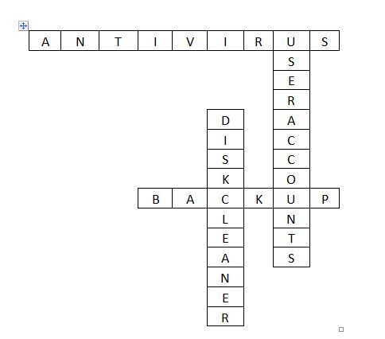
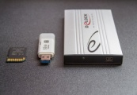
UTILITY PROGRAMS Can you identify the following utility programs on a computer?
CHALLENGE
ANSWERS

Slide 53
Utility Applications
KEY FACTS
Utilities Applications allow the user to manage the computer. The 2 key utilities are Maintenance Utilities and Security Utilities.
Maintenance Utilities may include features such as: File Management, Diagnostic tools, Backup, Disk Cleaner, Disk Fragmentation and Task Scheduling.
Security Utilities may include features such as: Anti-Virus Software, Firewalls and Management of User Accounts.
Different computer systems may have different system software facilities. These are usually accessible through the control panel or accessories folder.
Student Activity Page 30

Slide 54
Utility Applications
System Restore is useful when there are PC problems that cannot be corrected easily
This facility restores the PC or device to an earlier saved version or point in time
System and Restore
Tasks Performed

Slide 55
Utility Applications
Disk cleaner removes the address to the location of a file when the user deletes a file no longer required
Fragmentation causes slow computer performance, freezing and crashing
Defragmentation collects scattered pieces of data and brings them back together again
Like a house spring clean, its purpose is to clean up the hard drive, increase performance and speed
Disk Cleaner and Disk Fragmentation
Tasks Performed

Slide 56
Utility Applications
Allows the user to schedule automated tasks on the computer
It monitors the criteria the user enters and executes the program when the criteria is met
An example might be running a daily backup overnight
Task Scheduling
Tasks Performed

Slide 57
Anti-Virus Software
KEY FACTS
A virus is a malicious piece of code which is designed to attach itself to a program. Once infected, just like a biological virus it can replicate itself and spread from host to host. It can have devastating and disruptive effects on work productivity by altering computer settings or even cause it to stop working altogether. Viruses are usually obtained through downloading, opening untrustworthy email attachments or links.
Many PCs and digital devices have anti-virus programmes installed as part of the System Software. In addition, businesses and individuals may download or purchase additional anti-software to protect their PCs and networks. Examples include: AGV, Avira, Symantic, Norton.
Student Activities Page 31 to 33

Slide 58
Malware threats and harmful effects

Slide 59
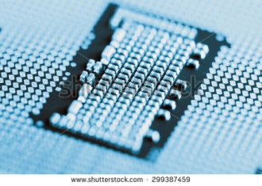
Computer Hardware
Learning Intentions
Students should be able to:
Explain the purpose of the central processing unit (CPU)
Describe the role of the following components of the CPU: the arithmetic logic unit (ALU), control unit and immediate-access store
Describe the role the following play in the fetch-execute-cycle: program counter, memory address register (MAR), memory data register (MDR), instruction address register (IAR) and ALU
Describe the impact of clock speed, cache size and number of cores on CPU performance
Describe the characteristics, typical uses, advantages & disadvantages of common input, output and storage devices

Slide 60
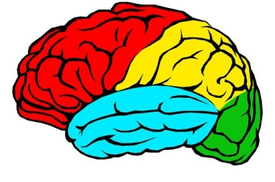
CPU: KEY TERMS
The Central Processing Unit (CPU) is often referred to as the brain of the computer. Its key purpose is to handle and execute instructions it receives from the hardware and software. Instructions are held in programs.
The CPU can be identified as the chip inside the motherboard of a PC or laptop which is held inside a CPU socket. It is usually square or rectangular in shape and has hundreds of pins that fit into the socket. Nowadays, numerous electronic devices such as mobile phones and washing machines rely on CPUs to operate. There a numerous processor specifications available for PCs and devices.
Animated Introduction to the CPU

Slide 61
CPU: KEY TERMS
There are 3 key components to the CPU: Control Unit, Immediate Access Store and Arithmetic Logic Unit.
The Control Unit informs the computer’s memory, Arithmetic Logic Unit, Input & Output devices how to respond to a program’s instructions, essentially decoding the instructions into commands.
The Immediate Access Store is where the data and programs that are currently running are stored e.g. a word document that is being edited.
The Arithmetic Logic Unit performs arithmetic calculations and logic operations e.g. 4 + 5, 5>2.
Student Activity Page 34

Slide 62
CPU: KEY TERMS
The Central Processing Unit’s speed is influenced by 3 key factors: Clock Speed, Number of Cores and Cache Memory.
The Clock Speed is the speed at which the CPU can carry out instructions. Clock speed is measured in cycles per second. One cycle per second is one hertz. The higher the clock speed, the more instructions the CPU can execute per second. Clock speed is usually measured in Megahertz or Gigahertz.
A CPU can contain one or more processing units, each unit is known as a Core. Modern CPUs can have two (dual), four (quad) or more cores. A dual core can fetch and execute two instructions in the same time it takes a single processor.
Cache is a tiny block of memory which is used to hold temporary or most commonly used instructions. The control unit automatically checks the cache before it tries to retrieve data in RAM because it is positioned closer to the Control Unit. The larger the cache size, the more quickly instructions can be fetched and processed.

Slide 63
Core, Dual Core and Quad Core
Emoji Demo
Class will be divided up into Individuals, Pairs, Groups of Four
Regardless of how you are divided your task is to make 4 paper emoji bookmarks. Each division should record the exact time it takes.

Slide 64
CPU task
Scenario Megan has requested a new laptop for her birthday. She is 15 and has just embarked on her GCSEs. Megan will require MS Office, Photoshop and access to the Internet to support her studies. For personal use, Megan enjoys using the computer to listen to music and SKYPE friends abroad. Megan frequently works between different programs.
Working in pairs, research laptop suppliers and find a suitable laptop which you believe provides the best value for money, based solely on the Clock Speed, Core and Cache facilities. Her budget is £500. Using suitable software, create a short 2 Slide Presentation to present to your peers which explains and justifies your decisions. The class will vote on the best one!
Student Activity Page 35

Slide 65
Fetch-Decode-Execute Cycle
The fetch-decode-execute cycle is a standard process which describe the steps required for processing to take place.
Fetch - Each instruction has a unique address held in the Memory Address Register (MAR). The CPU fetches data and instructions from main memory and stores them in the temporary storage place called the Memory Data Register (MRD). The Program Counter gives an address value of the location of where to find the next instruction. As each instruction is fetched, the program counter increases its stored value by one.
Decode - The CPU has to make sense of the instruction it has fetched. The instruction must be de-coded to prepare the chip for execution of the command. This might involve calculations or logical operations carried out by the Arithmetic Logic Unit (ALU).
Execute - In this part of the cycle data processing takes place i.e. the instruction is carried out.
Student Activity Page 36
Visual Explanation

Slide 66
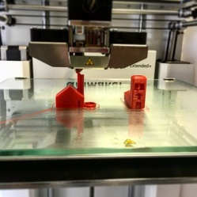
Input, Output, Both OR Storage Device
Notes:
Mouse – Input
3D Printer – Output
Storage Devices
Microphone – Input
Touch Screen – Input & Output
Speakers - Output

Slide 67
Input, Output, Storage Devices
STUDENT ACTIVITY 1 Working in a team of 4, allocate responsibility for researching and summarising in bullet points key information on the following Input, Output, Storage Devices & Memory. Each student should complete one table each electronically (using MS Word) and e-mail other team members their findings so they can copy/paste or write in their findings into individual Student Booklets. Each student should also print a copy of the table they were responsible for.
STUDENT ACTIVITY 2 (each team will be allocated a number) Cut out your completed tables and place in piles in the following categories: Name of Device, Technical Features & How it Works, Uses, Benefits and Drawbacks. On the back of each cut out, write in big letters the number of your team. Now shuffle each pack of cards. Swop yours with another team. On an A3 sheet of paper attempt to put the relevant information back together, using glue to stick it to the paper. Can you add anything new to your own tables?

Slide 68
Input Devices

Slide 69
Input Devices

Slide 70
Output Devices
3D Printing in Action

Slide 71
Storage Devices
Hard-Disk Drive in Operation

Slide 72
Computer Memory
Storage and Memory

Slide 73
Network Technologies
Learning Intentions
Students should be able to:
Describe the main features of a local area network (LAN) and a wide area network (WAN)
Describe the difference between the World Wide Web, the Internet of Things and Intranets
Describe and evaluate the effectiveness of common network communication technologies
Describe the function of common network resources
Describe the following network topologies: Bus, Star, Ring
Describe the advantages & disadvantages of networks

Slide 74
Network Technologies Starter
What year were the following online communication networks were launched?
Twitter
2006
E-Mail
1972
Facebook
2004
Youtube
2005
E-bay
1995
Instagram
2010
LinkedIn
2003
Student Activity Page 43

Slide 75
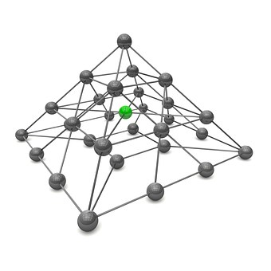
Introduction to Networks
What is a Network?
A computer network is a collection of computers that have been linked together so that they can communicate with each other allowing them to share hardware, software and data.
On a typical network ‘application software’ and users’ data files are stored on a powerful central computer called a FILE SERVER. The server manages the resources available to network users.

Slide 76
Introduction to Networks
What is a file server?
A server is a powerful computer which holds the operating system software to run the network e.g. Windows NT.
It will hold:
The network operating system software such as Microsoft Windows
Application software such as Word
User files created by the users on the system
System software that will manage the network resources and security
Utility software such as anti-virus software
Tasks include monitoring the network, creating usersallowing access permissions on files and folders. In schools, technicians are employed to manage the servers.

Slide 77
Local Area Networks (LAN)
A LAN is where computers are connected together on the same site e.g. office, old school network
Each computer on a LAN is called a workstation. All of the workstations are connected to each other and to the server
To use a LAN you have to identify yourself to the server by giving your user ID and password. When you have finished using the network you Log Off – this disconnects you from the network
LANS are normally owned, controlled and managed by a single person or organisation

Slide 78
Networks: Advantages & Disadvantages
Programs and Files can be stored on the File Server, allowing them to be shared and accessed from any workstation
Useful for internal communication e.g. E-Mail
Files can be backed up easily in a central location
Site licences are usually cheaper than buying for several stand alone computers
Data is generally more secure
Purchasing and Setting Up a LAN can be expensive
Someone must have responsibility for managing the File Server
If the File Server breaks down the network is not accessible anywhere
There is a greater threat from hackers and the spread of viruses – virus updates need constantly loaded.
Advantages
Disadvantages

Slide 79
Wide Area Networks (WAN)
A Wide Area Network usually expands over a large geographical area. The Internet is the world’s largest WAN
The Internet is a WAN as it connects lots of LANs together, allowing them to communicate
Computers are connected to a WAN through telephone, leased lines or satellites
Student Activities Page 45 to 47

Slide 80
Network Topologies

Slide 81
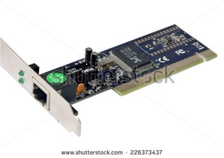
Network Resources
KEY TERMS
A network interface card enables each computer to connect with the network, so that it can communicate with the file server and other computers on the network.
Network cables are plugged into the back of each computer into the network card from the network point. Further cables are usually kept behind a protective shield and connected from there to a switch. Data travels along the network cables.
The switch is connected to a file server and enables computers and other devices to communicate with the file server and other computers on the network. One ICT lab or computer room may be connected to the same switch.
A Router connects networks. It enables the LAN and computers on the network to access the Internet or other WANs.

Slide 82
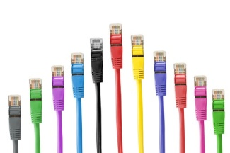
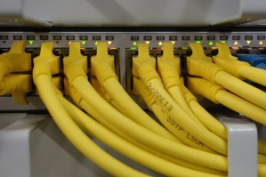
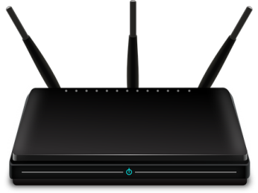
Network Resources
Network Interface Card (NIC)
Network Cables
Switch
Router

Slide 83
WWW, Internet of Things, Intranet
Student Activities Pages 49 to 51
KEY TERMS
Sir Tim Berners-Lee is a Computer Scientist who invented the World Wide Web in 1989. http://webfoundation.org/ WWW is webspace containing a collection of web pages that have a Uniform Resource Locator (web address). These are interconnected through hyperlinks to pages formatted in a language called Hypertext MarkUp Language which are displayed in an understandable form to the user.
The Internet is a global system where computer networks can connect to each other. The WWW and the Internet are not the same thing, but they are inter-dependent on each other.
The Internet of Things is a concept where all sorts of physical devices, software, electronic and mechanical objects can inter-connect and exchange data.
An Intranet is an internal, private network that is only accessible to individuals within the organisation. For example, Your School Network: FRONTER, Shared Resources, C2K E-Mail. Intranets are only accessible through a User Name and Password.

Slide 84
Components of a URL Address
Address bar
This allows the user to enter the web address or URL of the website they wish to visit. A URL is a Uniform Resource Locator. This is another name for the website address. For example the URL for the BBC website is http://www.bbc.co.uk

Slide 85
Web Browsers
A Web Browser is a type of software application required for viewing, downloading and uploading material to the Internet or offline web pages. One example is Internet Explorer.
CLASS FEEDBACK
What other web browsers are there?
Describe 2 key facts about each

Slide 86
Search Engines
A Search Engine facility is used to search the Internet to find relevant websites and web pages that are matched to the criteria the user has entered. One example is Google.
CLASS FEEDBACK
What other search engines are available?
Describe 2 key facts about each

Slide 87
Internet Service Provider (ISP)
An Internet Service Provider (ISP) is required to access the Internet. Individuals and Businesses usually pay the ISP on a monthly basis to have access to the Internet and a range of other services. Examples of ISPs include: BT, Sky.
CLASS FEEDBACK
Typical services provided by an ISP?

Slide 88
Intranets
An Intranet is an internal, private network that is only accessible to individuals within the organisation. For example, Your School Network: FRONTER, Shared Resources, C2K E-Mail. Intranets are only accessible through a User Name and Password.
E-MAIL ... Used by teachers and pupils for?
SHARED RESOURCES?
FRONTER / MOODLE?
APPS?

Slide 89
Network Communication Technologies

Slide 90
School Network Help Guide Task
Create a Newsletter in MS Word OR MS Publisher which provides an Introduction to Year 8 students about the school network. You should include the following sub headings: (1) An introduction to the School Network – what it does, how it works and the key features (2) Accessing the School Network from school and at home (3) Accessing E-mail and information to expect in your inbox and how you might use it to support your studies (4) A description of the key APPS and a brief description of their purpose and use – this may include software such as MS Word, Excel & PowerPoint AND others such as FRONTER (5) Accessing The Internet, key features and terms

Slide 91
Cyberspace, Network Security and Data Transfer
Learning Intentions
Students should be able to:
Define the term cybercrime and give examples of threats to cybersecurity
Define the term malware and describe common forms of malware
Explain how networks and data can be protected
Describe the role of a protocol for data transfer
Describe the purpose of well known protocols

Slide 92
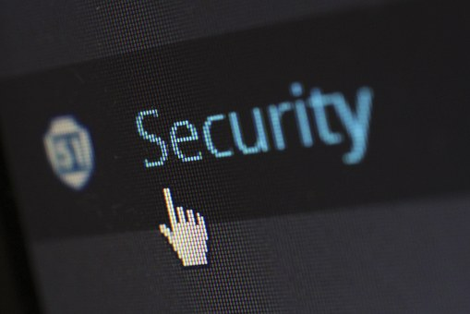
Cybercrime
Introduction to Cybercrime 1st 10 minutes
KEY TERM Cybercrime is a criminal activity carried out by using digital technologies.
Class Discussion
What is cybercrime?
Why does the number of cybercrimes continue to increase?
What type of people are most vulnerable
How can we reduce the risk of being a target of cybercrime?
Student Activity Pages 54

Slide 93
Cybercrime Threats
Match the cybercrime threats to the correct definition
Hacking
Unauthorised access to a computer or network
Pornography
Explicit images, videos or written material for the purpose of sexual arousal
Cyber Stalking
Electronic communication designed to scare or threaten
Data Theft
Stealing information from an individual, business or organisation
Denial of Service
Disrupting services by making it unavailable to users
Digital Forgery
A fraud that involves altering digital documents or images
Cyber Defamation
Digital slander or upload of material against another person
Spamming
Sending emails or texts to large numbers of people for marketing purposes
Phishing
A fraud where criminals portray themselves as someone else to collect sensitive data

Slide 94
Anti-Cybercrime Campaign
Create an A3 Poster which provides information for vulnerable people on how they can avoid being a victim of cybercrime. You should include the following: (1) A Slogan for your A3 Poster campaign (2) Recent newspaper cut-outs or online stories about cybercrime and its impact on society (3) Summarised key points of advice on what to look out for, what to do and what not to do (4) Relevant images to support your message

Slide 95
Anti-Virus Software Revision
KEY FACTS
A virus is a malicious piece of code which is designed to attach itself to a program. Once infected, just like a biological virus it can replicate itself and spread from host to host. It can have devastating and disruptive effects on work productivity by altering computer settings or even cause it to stop working altogether. Viruses are usually obtained through downloading, opening untrustworthy email attachments or links.
Many PCs and digital devices have anti-virus programmes installed as part of the System Software. In addition, businesses and individuals may download or purchase additional anti-software to protect their PCs and networks. Examples include: AGV, Avira, Symantic, Norton.

Slide 96
Malware Revision

Slide 97
Network Security Threats
There are many threats to Network Security.
Networks must be protected from:
Unauthorised access to confidential files, software and data
Physical abuse
Viruses and other malware
System failure and disruption of services
Other forms of Cybercrime

Slide 98
Methods used to protect networks
Users may be provided with a unique User ID and Password to access the network. The User ID identifies the person as an authorised network user and the password clarifies it is the user.
Larger networks are likely to provide different Levels of access to the network. For example, The C2K Manager will have read/write access on all areas of the network; Teachers will have read/write access to some areas of the network e.g. Staff and Shared Resources, whereas pupils will have read only access to Shared Resources. Businesses and other organisations use a similar approach.

Slide 99
Methods used to protect networks
Network data is often protected through encryption, usually to protect sensitive date such as bank account numbers and personal information. Encryption scrambles the data so that if information is accessed by an unauthorised user they will only see a meaningless string of data. The data can be unscrambled by the intended recipient by entering an encryption key to decode it.
Networks can crash from time to time and to ensure data is not lost there will be backup procedures in place. Networks are often backed up on a daily, weekly and monthly basis. Some organisations may still use magnetic tape for this purpose or the more modern method of backing up on the cloud.

Slide 100
Methods used to protect networks
The main function of anti-virus software is to detect and remove viruses by scanning the PC or electronic device and comparing it to a database of known viruses. The database and virus protection software must be up-to-date to be effective. When a virus is detected, it is quarantined and the computer notifies the user so that the file can be deleted.
A firewall can include a combination of both hardware and software. Its job is to monitor incoming and outgoing traffic to the network. It is designed to either allow or block data according to a set of security rules. Its purpose is to prevent unauthorised access to the network.

Slide 101
Protocols
Student Activity Page 57
A protocol is an industry standard set of rules for communication and exchanging data on a network.

Slide 102
GoTelecom Scenario Task
Scenario: You are the Network Manager for GoTelecom who provide a mobile telephone service. A new network has recently been installed and you have been asked to present a 3 minute presentation informing staff about Network Security and advising them on preventative measures. You should research and include the following: (1) 5 Slides – Slide 1 should include an Introduction to the purpose of the Presentation (2) Key points only that you will use as a guide to support your speech and relevant images (3) Advice on the following aspects: (a) Logging On/Off, Locking, Choosing a Password, Password Secrecy (b) Saving and Backing Up Data on the Network (c) Viruses and other malware – how to reduce the threat on the network (d) Communications – acceptable and unacceptable use of the network

Slide 103
Cloud Technology
Learning Intentions
Students should be able to:
Define the term cloud computing
Describe the advantages and disadvantages of cloud computing
Describe the impact of cloud computing on gaming, file storage and sharing
Demonstrate knowledge and understanding of related laws and legislation
Describe the terms hacker, virus and spyware and how these relate to the Computer Misuse Act

Slide 104
Cloud Technology
Cloud computing is an alternative and modern way to store, manage and process data. Instead of storing data on a local network, stand alone computer or external storage device it is accessed, processed and stored on the Internet. The data itself is stored in data centres all over the world.
Student Activity Pages 59

Slide 105
Cloud Technology
CLASS FEEDBACK
How has cloud computing impacted on Gaming?
What are the advantages?
What are the disadvantages?
How has cloud computing impacted on communication?
What are the advantages?
What are the disadvantages?
How has cloud computing impacted on entertainment?
What are the advantages?
What are the disadvantages?

Slide 106
Cloud Technology
Cloud computing is not only used at home, but has also become a popular method of data storage for businesses and other organisations. They also use cloud computing for collaboration and file sharing e.g. Drop box.
Cloud Technology in Business
Student Activities Page 60

Slide 107
Cloud Technology Advantages & Disadvantages
Unlimited Storage Capacity
Backup and Recovery much easier than on a physical device
Cheaper than installing a multi-user system or network or buying software
Computer efficiency is better as less storage space is used up
Accessible 24/7 and accessible anywhere with Internet access
Requires a reliable internet and broadband connection
Technical problems can arise meaning there is no access for periods of time
Web based applications may have limited features compared to traditional ones
Security risks whereby all data is accessible to a 3rd party cloud provider and it may be prone to hacking attempts
Advantages
Disadvantages

Slide 108
Moral and Ethical Considerations
Learning Intentions
Students should be able to:
Describe the ethical impact of technology on society referring to the following: internet misuse, social media misuse, the implications of global positioning system and tracking, concerns about the security of personal data

Slide 109
Ethical, Legal & Environmental Impact of Digital Technology
Intro Video
The purpose of the Consumer Contracts (Information, Cancellation and Additional Charges) Regulations 2013 is to protect the consumer and outlines details about contracts between the trader and the buyer.
http://www.which.co.uk/consumer-rights/regulation/consumer-contracts-regulations
Student Activity Page 61

Slide 110
Ethical, Legal & Environmental Impact of Digital Technology
The purpose of the Copyright, Design & Patents Act 1988 is to protect and recognise the time and effort that has gone into creating original works of authors, musicians, video producers and software programmers. The Act also provides the creator with the authority to control how their work is used.
Student Activity Page 62

Slide 111
Ethical, Legal & Environmental Impact of Digital Technology
Whatever school, club or online system we become a member of, personal data is usually requested and stored. The purpose of the Data Protection Act 1998 is to protect individuals and control how their data is used.
https://ico.org.uk/for-organisations/guide-to-data-protection/
http://www.bbc.co.uk/schools/gcsebitesize/ict/legal/0dataprotectionactrev1.shtml
Student Activity Page 63

Slide 112
Ethical, Legal & Environmental Impact of Digital Technology
Hacking, unauthorised access and purposeful attempts to spread viruses or damage to a computer system are an illegal offence. The purpose of the Computer Misuse Act 1990 is to protect computer users and provide information about such offences.
http://www.legislation.gov.uk/ukpga/1990/18/contents
Student Activity Page 64

Slide 113
Our Digital Footprint
Activity 1
In allocated groups on an A3 sheet OR electronically, list all the ways you can think of that we produce our own digital footprint. Consider potential threats and concerns. Groups to feedback to the class. Update your own list on Page 65 Student Booklet after class feedback.
Activity 2
Choose one category and create a Storyboard for a short movie clip (using the outline below) illustrating 2 different ways technology can be misused and the potential impact of each. The advertisement should last no more than 40 seconds in 6 clips and will be created in Movie Maker.
Activity 3
Create the movie clip

Slide 114
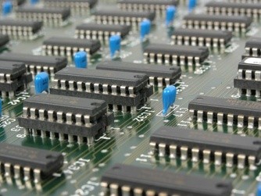
Changes in Employment
Learning Intentions
Students should be able to:
Describe the impact of digital technology on employment including: increased job opportunities in the digital technology and computing sector, job displacement, changes in work patterns and the need for upskilling

Slide 115
Impact of Digital Technology on Employment
Intro Video Clip
Careers Activities Focused Lesson Pages 71 to 73

Slide 116
Impact of Digital Technology on Employment
Job Displacement is where jobs are lost or no longer required. This is often the case when a position or specific job role is replaced by Digital Technologies, for example, Robots, Machinery, Artificial Intelligence
Working patterns have changed in many industries over the years. In some cases they are implemented because of legal obligations, for example, part-time, flexi hours, job-sharing. In other cases they have become possible through changes in Digital Technologies, for example, teleworking.
Up skilling of employees is often required as digital technologies continue to develop and working practices change.
Student Activity Page 74

Slide 117
Teleworking Debate
You are a web developer and employee at Web Creations. Your task today is to prepare for an organised company debate on the introduction of teleworking to the business. Debating Teams You will be allocated to one of the following teams: Team 1 – Managers (for the introduction of teleworking) Team 2 – Managers (against the introduction of teleworking) Team 3 – Employees (for the introduction of teleworking) Team 4 – Employees (against the introduction of teleworking)
Student Activity Page 75

Slide 118
Health and Safety
Learning Intentions
Students should be able to:
Demonstrate understanding of the digital technology related to health and safety issues, including RSI, back strain and eye strain
Identify the measures that both the employee and employer should take to promote good health and safety practice in the workplace

Slide 119
Health & Safety (Digital Technology)
The Health & Safety (Display Screen Equipment) Regulations 1992 was introduced to protect employees who regularly use display screen equipment, including computers, laptops and other digital devices as part of their normal working routine. There is a number of health risks associated with the use of DSE and employers have legal obligations to put practice to reduce risks to their employees.
Health Risks associated with prolonged use of DSE include fatigue, eyestrain, headaches, back strain, repetitive strain injury (RSI) and stress.
Student Activity Page 76

Slide 120
Health & Safety (Digital Technology)
OTHER MEASURES EMPLOYERS CAN TAKE TO REDUCE RISKS OF USING DISPLAY SCREEN EQUIPMENT Staff Training to ensure that employees are aware of company policy on the issue and how they can reduce personal risks.
Examples include: reporting equipment concerns, adopting a proper posture, keeping wrists off the table when typing, adjusting their chair to the correct height, adjusting the blinds for correct lighting, taking regular breaks or changing activities, annual eye tests.

Slide 121
Go2BankOnline Case Study
Produce a poster than can be copied and displayed around the workplace which promotes good health and safety practice in the workplace.
Student Activity Page 77

Slide 122
Digital Applications
Learning Intentions
Students should be able to:
Describe the main features of gaming applications, simulations and mobile phone applications and how they are used to support: education and training, social interactions, work practices
Evaluate the impact of online banking, online training and e-commerce on our every day lives
Student Research Activities Pages 78 to 79

Slide 123
Develop an APP
In teams, create a plan to implement a simple mobile app of your own designed to perform a specific task, topic revision/test e.g. homework reminder. This can be a game, simulation or social media type app for educational OR work purposes. Each team should present your ideas to the class using an A3 Poster to illustrate.
Student Activity Page 80

Slide 124
Online Banking
Customers can access their bank account using the bank’s secure website. This is known as online banking. The customer registers for online banking to be able to use this facility. It involves the customer logging on by entering a username and password. The customer may be asked for certain verification data to access their account.
Key Features:
24/7 access to your bank account via the Internet
Online statements
Transaction history
Ability to transfer funds between accounts
Can set up, view and cancel Direct Debits and Standing Orders
SMS facilities
Student Activities Pages 83 to 84

Slide 125
Online Banking Advantages
Convenience of banking online
Can set up and receive notifications if your bank account falls below a certain amount
Can monitor income and spending more easily
Can transfer money instantly
Less branches and staff required
Financial savings in buildings, salary
Reduction in errors as customers have more control over their account
Bank does not need to be open for transactions to occur
Customers
Bank

Slide 126
Online Banking Disadvantages
Customer Service may not be as good as face to face
Relies on Internet Access
A first time user may find it difficult and no training is provided
Hacking threat and security of transactions
Bank server down then unable to access account
Less of a personal touch and relationship with customers
More difficult to sort customer issues
Less money made in charges because customers can monitor their account more easily
Online banking competition
Customers
Bank

Slide 127
E-Commerce
Student Activities Pages 81 to 82
Key Features:
Buying and selling goods and services online
Examples include: Online Bookings such as flights, hotels and concerts, Shopping
May require an account login to purchase and/or sell goods
Charges sometimes apply

Slide 128
E-Commerce Advantages
Convenience of shopping online
Can browse and compare goods and services before purchasing
More consumer choice
Can access shops that are not on the doorstep
No physical shop and less staff required
Financial savings in buildings, salary
Shop does not need to be open for transactions to occur
Convenience of working from home
Can monitor buyer habits more easily
Consumers
Sellers

Slide 129
E-Commerce Disadvantages
Customer Service may not be as good as face to face
Relies on Internet Access
Hacking threat and security of transactions
Cloud server down then unable to access account
Unable to see physical products until they arrive
Less of a personal touch and relationship with customers
More difficult to sort issues out
Consumers may give negative reviews
Increasing online competition
Consumers
Sellers

